Slide 1
Chapter 1:
Data Storage
Computer Science: An Overview
Twelfth Edition
by
J. Glenn Brookshear
Dennis Brylow

Slide 2
Data Storage
1.1 Bits and Their Storage
1.2 Main Memory
1.3 Mass Storage
1.4 Representing Information as Bit Patterns
1.5 The Binary System
1-<number>

Slide 3
Data Storage (continued)
1.6 Storing Integers
1.7 Storing Fractions
1.8 Data and Programming
1.9 Data Compression
1.10 Communications Errors
1-<number>

Slide 4
Bits and Bit Patterns
Bit: Binary Digit (0 or 1)
Bit Patterns are used to represent information
  Numbers
  Text characters
  Images
  Sound
  And others
1-<number>
Notes:
Inside today’s computers information is encoded as patterns of 0s and 1s. These digits are called bits (short for binary digits).
Sometimes patterns of bits are used to represent numeric values; sometimes they represent characters in an alphabet and punctuation marks; sometimes they represent images; and sometimes they represent sounds.
Although you may be inclined to associate bits with numeric values, they are really only symbols whose meaning depends on the application at hand.

Slide 5
Bits and Bit Patterns
Computers represent data and instructions with patterns of bits.
In most computer documentation, 8 contiguous bits are called a byte. A bit holds a 0 or a 1, possibly representing the on/off (or high/low) condition of a switch.
1-<number>

Slide 6
Bits and Bit Patterns (cont.)
Ques: How many patterns can be formed with a single bit?
1-<number>

Slide 7
Bits and Bit Patterns (cont.)
Ans: With one bit there are two possible patterns.
0 and 1 (or "off" and "on", or "false" and "true“ or “low” and “high”).
1-<number>

Slide 8
Bits and Bit Patterns (cont.)
Ques: How many patterns can be formed with two bits?
1-<number>

Slide 9
Bits and Bit Patterns (cont.)
Ans:
  0 0 0
  0 0 1
  0 1 0
  0 1 1
  1 0 0
  1 0 1
  1 1 0
  1 1 1
1-<number>

Slide 10
Bits and Bit Patterns (cont.)
Ques: Is the pattern 0 1 different from the pattern 1 0?
1-<number>

Slide 11
Bits and Bit Patterns (cont.)
Ans: Yes ― the position of a bit matters.
1-<number>

Slide 12
Bits and Bit Patterns (cont.)
Ques: How many patterns can be formed with three bits?
1-<number>

Slide 13
Bits and Bit Patterns (cont.)
  Ans:
  0 0 0
  0 0 1
  0 1 0
  0 1 1
  1 0 0
  1 0 1
  1 1 0
  1 1 1
8 patterns.
1-<number>

Slide 14
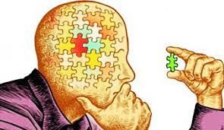

Bits and Bit Patterns (cont.)
It looks like the number of patterns that can be formed with N bits is greater than the number of bits.
What do you think?
Ans: Yes ― much greater.
This simple fact is of profound importance to computer science.
Is there a relationship between number of patterns with N bits?
1-<number>

Slide 15
Bits and Bit Patterns (cont.)
Ques: How many patterns can be formed from three bits?
Ans: 8 patterns can be formed from three bits.
Ques: How many patterns can be formed from N bits?
Ans: Twice the number of patterns that can be formed from (N-1) bits.
1-<number>

Slide 16
Bits and Bit Patterns (cont.)
The list of patterns for three bits has 8 lines (patterns).
To form the list of patterns for 4 bits,
make two copies of the list for 3 bits.
This gives you 16 lines.
Each line is made unique by prefixing the first half with "0" and the second half with "1".
1-<number>

Slide 17
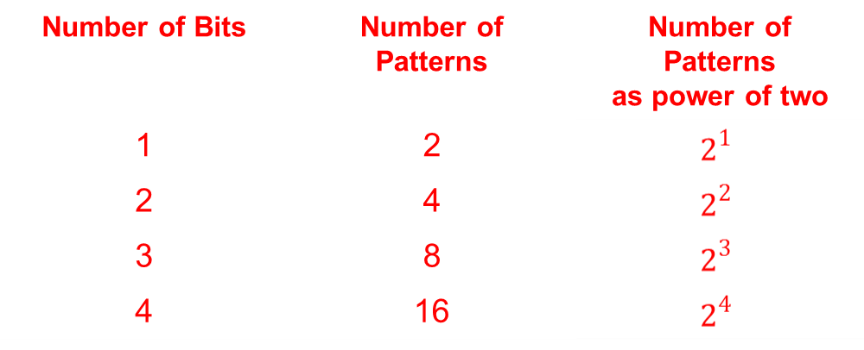
Bits and Bit Patterns (cont.)
The trick can be repeated as many times as you like.
Adding one more bit doubles the number of patterns.
The table shows the number of patterns for 1, 2, 3 and 4 bits.
1-<number>

Slide 18
Bits and Bit Patterns (cont.)
How many patterns with 5 bits?
Make two copies of the 4-bit patterns (16 patterns per copy).
Make the patterns unique by prefixing "0" to the first 16 patterns and "1" to the second 16.
You now have 16×2 = 2⁵ unique patterns.
This demonstrates the following:
Number of possible patterns of N bits = 2^{N}
1-<number>

Slide 19
Bits and Bit Patterns (cont.)
How many patterns can be formed with 10 bits? Use the formula:
2¹⁰ = 1024
This number (i.e. 1024) occurs often in computer science.
1024 bytes is called a kilobyte, abbreviated K and pronounced "Kay".
1-<number>

Slide 20
Bits and Bit Patterns (cont.)
Ques: In the past, some computers used 16 bits to form memory addresses. Assuming no special tricks (which such limited machines often used), how many bytes maximum could be held in main storage?
Ans: 64K bytes:
2¹⁶ = 2⁽⁶ ⁺ ¹⁰⁾ = 2⁶ × 2¹⁰ = 64K
1-<number>

Slide 21
More about patterns
Many calculations involving bit patterns use the following familiar fact of arithmetic.
2^{(N+M)} = 2^{N} × 2^{M}
The number of patterns that can be formed with 10 or more bits are usually expressed as multiples of 1024 (= 2¹⁰) or in "Megs" (= 2²⁰).
For example, how many patterns can be formed from 24 bits?
2²⁴ = 2⁴ × 2²⁰ = 16 Meg
The power of two (24) splits into a small part (2⁴) and a part that has a name (2²⁰ = Meg).
This is a useful trick you can use to amaze your friends and impress employers.
1-<number>

Slide 22
Bits and Bit Patterns (cont.)
Some audio cards use 12 bits to represent the sound level at an instant in time (12 bits per sample). How many signal levels are represented?
2¹² = 2² × 2¹⁰ = 4K levels
1-<number>

Slide 23
Pattern names
Consider the following pattern:
0010100010101010
It is not easy to work with. It is convenient to break bit patterns into 4-bit groups (called nibbles):
0010 1000 1010 1100
There are 16 ( = 2⁴ ) possible patterns in a nibble. Each pattern has a name, as seen in the table.
1-<number>

Slide 24
Hexadecimal Names
nibble | pattern name | nibble | pattern name
0000 | 0 | 1000 | 8
0001 | 1 | 1001 | 9
0010 | 2 | 1010 | A
0011 | 3 | 1011 | B
0100 | 4 | 1100 | C
0101 | 5 | 1101 | D
0110 | 6 | 1110 | E
0111 | 7 | 1111 | F
1-<number>

Slide 25
You might be tempted to call those 4-bit patterns "binary numbers". Resist that temptation. The bit patterns in computer main memory are used for very many purposes. Representing integers is just one of them. The fundamental concept is "bit patterns". Don't confuse this concept with one of its many uses: "representing numbers".
The above bit pattern can be written using the pattern names:
0010 1000 1010 1100 = 28AC
Bits are grouped into nibbles starting at the right. Then each nibble is named. This method of giving names to patterns is called hexadecimal.
1-<number>

Slide 26
Hexadecimal Names
nibble | pattern name | nibble | pattern name
0000 | 0 | 1000 | 8
0001 | 1 | 1001 | 9
0010 | 2 | 1010 | A
0011 | 3 | 1011 | B
0100 | 4 | 1100 | C
0101 | 5 | 1101 | D
0110 | 6 | 1110 | E
0111 | 7 | 1111 | F
1-<number>

Slide 27
QUES: Name the following patterns:
  0001 0001
  0011 1001
  1011 1111
  0100 0110
  0000 0000
1-<number>

Slide 28
Ans:
0001 0001 11
0011 1001 39
1011 1111 BF
0100 0110 46
0000 0000 00 (be sure to show both zeros)
1-<number>

Slide 29
Hex practice
If there are not enough bits at the left to form a complete group of four, add zero bits to the left, (but be sure that it is clear by context how many bits you are describing). For example:
1010000010000010 = 1010 0000 1000 0010 = A082 Another example:
10100110101111 = 10 1001 1010 1111 = 0010 1001 1010 1111 = 29AF
1-<number>

Slide 30
Hex practice (cont.)
Usually '0x' is placed at the front of a pattern name to show that it is a hexadecimal pattern name:
  0x0010 = 0000 0000 0001 0000
  0xFACE = 1111 1010 1100 1110
1-<number>

Slide 31
Hex practice (cont.)
Adding zeros to the left of a pattern creates a new pattern. The new pattern has its own name. 0x0 = 0000 is a different pattern than
0x00 = 0000 0000. Sadly, people are not consistent about this, and depending on context, both patterns might be called "0x0".
Keep in mind that hexadecimal pattern names are used by humans for talking about bit patterns. Inside the computer there are only bits and their patterns. Hexadecimal is used in books and documents (outside the computer) to describe these bit patterns.
1-<number>

Slide 32
Hex practice (cont.)
QUES: Name the following patterns; include 0x in the name:
0000 1010 0001 0001
0001 0010 1001 1010
1111 1010 1101 1110
0011 0110 1100 0000
0000 0000 0000 0000
1-<number>

Slide 33
Hex practice (cont.)
Answer:
0000 1010 0001 0001 0x0A11
0001 0010 1001 1010 0x129A
1111 1010 1101 1110 0xFADE
0011 0110 1100 0000 0x36C0
0000 0000 0000 0000 0x0000 (be sure to show all zeros)
1-<number>

Slide 34
Octal
Sometimes documentation describes bit patterns in groups of three. Three-bit groups are named using the first eight pattern names of hexadecimal. This method is called octal notation.
A bit pattern can be named using hexadecimal names, octal names, or many other notations.
Example:
  01101010 = 01 101 010 = 152 (octal)
  01101010 = 0110 1010 = 0x6A (hex)
1-<number>

Slide 35
Octal
Octal is awkward to use with 8-bit bytes. Bytes don't evenly split into octal pattern names. But you should know about it. Historically, some computer documentation used octal pattern names. Also, in several programming languages (C and Java among them) octal notation is indicated by a leading zero:
0152 (octal) = 001 101 010
0x152 (hex) = 0001 0101 0010
152 (decimal) = 10011000
1-<number>

Slide 36
Octal
When the number of bits is not a multiple of three it is conventional to add zero bits to the left, and then to name the pattern as usual. This happens frequently because computer memory is organized into 8-bit bytes, which do not divide evenly into groups of three.
1-<number>

Slide 37
Octal
QUES: What is the OCTAL pattern name of the following bit patterns:
111 010 001
100 011 010
011011110
11000000
1-<number>

Slide 38
Ans:
111 010 001 0721
100 011 010 0432
011011110 0336
11000000 0300
1-<number>

Slide 39
Boolean Operations
Boolean Operation: An operation that manipulates one or more true/false values
Specific operations
  AND
  OR
  XOR (exclusive or), ENOR
  NOT
  NAND and NOR,
1-<number>
Notes:
AND reflect the truth or falseness of a statement formed by combining two smaller, or simpler, statements with the conjunction and.
Such statements have the generic form
P AND Q
where P represents one statement, and Q represents another—for example,
Kermit is a frog AND Miss Piggy is an actress.

Slide 40
Boolean operations (Cont.)
AND reflect the truth or falseness of a statement formed by combining two smaller, or simpler, statements with the conjunction and.
Such statements have the generic form
P AND Q
where P represents one statement, and Q represents another—for example,
Kermit is a frog AND Miss Piggy is an actress.
The OR operation is based on compound statements of the form
P OR Q
where, again, P represents one statement and Q represents another. Such statements are true when at least one of their components is true.
1-<number>

Slide 41
Boolean operations (Cont.)
XOR produces an output of 1 (true) when one of its inputs is 1 (true) and the other is 0 (false). For example, a statement of the
form P XOR Q means “either P or Q but not both.”
The operation NOT is another Boolean operation. It differs from AND, OR, and XOR because it has only one input. Its output is the opposite of that input; if the input of the operation NOT is true, then the output is false, and vice versa.
1-<number>

Slide 42
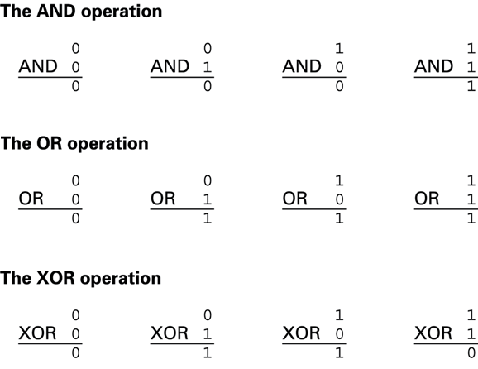
Figure 1.1 The possible input and output values of Boolean operations AND, OR, and XOR (exclusive or)
1-<number>

Slide 43
Gates
Gate: A device that computes a Boolean operation
  Often implemented as (small) electronic circuits
  Provide the building blocks from which computers are constructed
  VLSI (Very Large-Scale Integration)
1-<number>
Notes:
A device that produces the output of a Boolean operation when given the operation’s input values is called a gate.
Inside today’s computers, gates are usually implemented as small electronic circuits in which the digits 0 and 1 are represented as voltage levels.
Gates provide the building blocks from which computers are constructed.
Very large-scale integration (VLSI), allows millions of electrical components to be constructed on a wafer (called a chip), is used to create miniature devices containing millions of flip-flops along with their controlling circuitry. Consequently, these chips are used as abstract tools in the construction of computer systems. In fact, in some cases VLSI is used to create an entire computer system on a single chip.

Slide 44
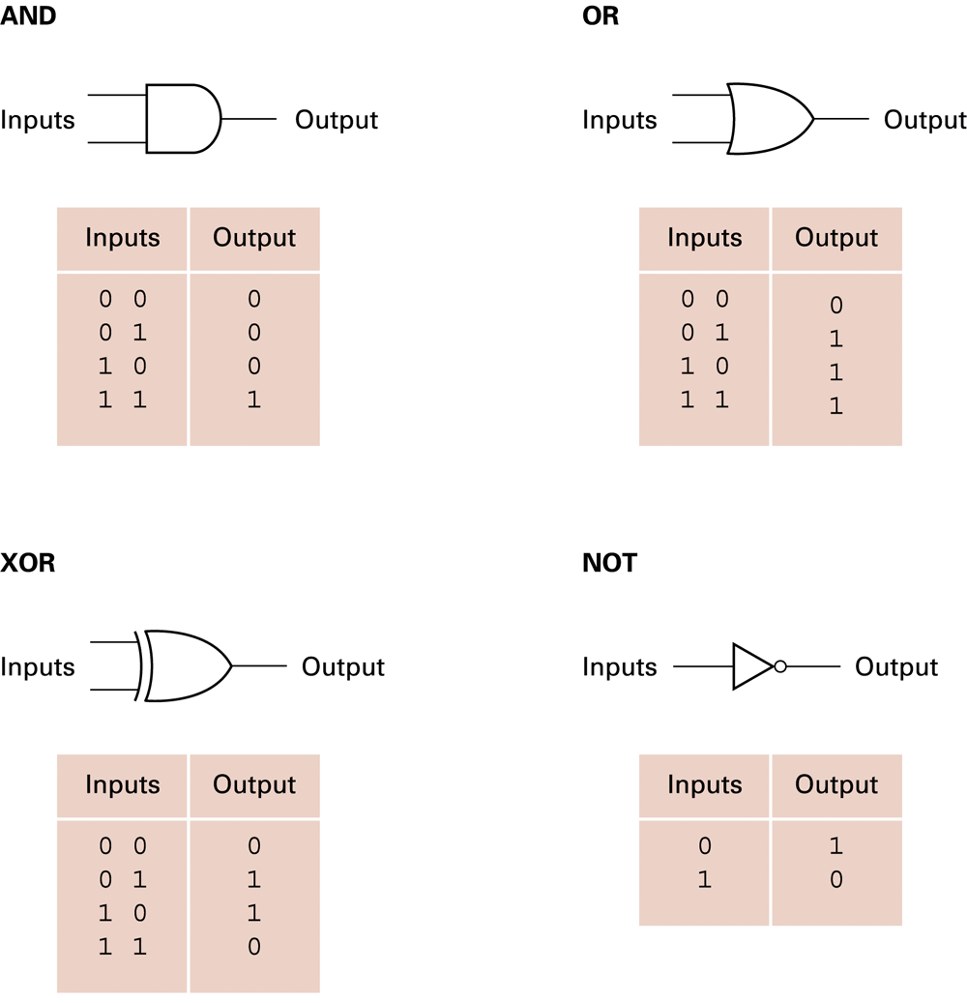
Figure 1.2 A pictorial representation of AND, OR, XOR, and NOT gates as well as their input and output values
1-<number>
Notes:
Students to draw logic gate for NOR and NAND and their truth tables

Slide 45
Question for the class
Assignment 1
What is the symbol for NAND and NOR gates? Draw the truth table of each.
1-<number>

Slide 46
Flip-flops
Flip-flop: A circuit built from gates that can store one bit.
  One input line is used to set its stored value to 1
  One input line is used to set its stored value to 0
  While both input lines are 0, the most recently stored value is preserved
  Flip-flop is a single bit storage devices
  Memories are designed using flip-flops
1-<number>
Notes:
A flip-flop is a fundamental unit of computer memory. It is a circuit that produces an output value of 0 or 1, which remains constant until a pulse (a temporary change to a 1 that returns to 0) from another circuit causes it to shift to the other value. In other words, the output can be set to “remember” a zero or a one under control of external stimuli. As long as both inputs in the circuit in Figure 1.3 remain 0, the output (whether 0 or 1) will not change. However, temporarily placing a 1 on the upper input will force the output to be 1, whereas temporarily placing a 1 on the lower input will force the output to be 0.

Slide 47
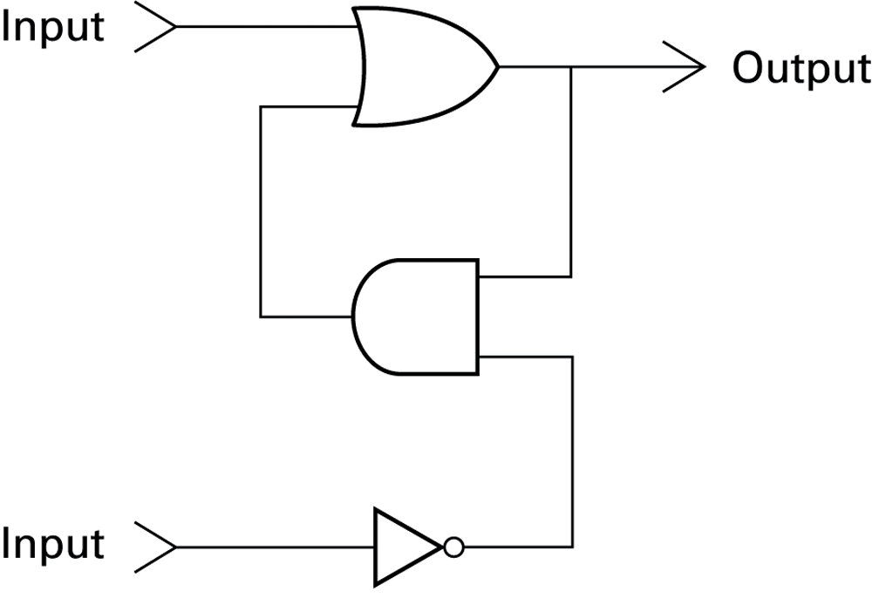
Figure 1.3 A simple flip-flop circuit
1-<number>

Slide 48
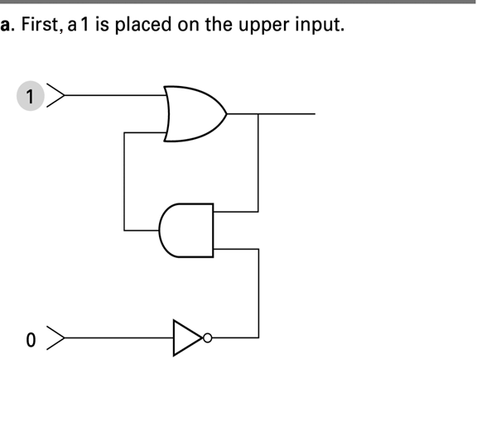
Figure 1.4 Setting the output of a flip-flop to 1
1-<number>

Slide 49
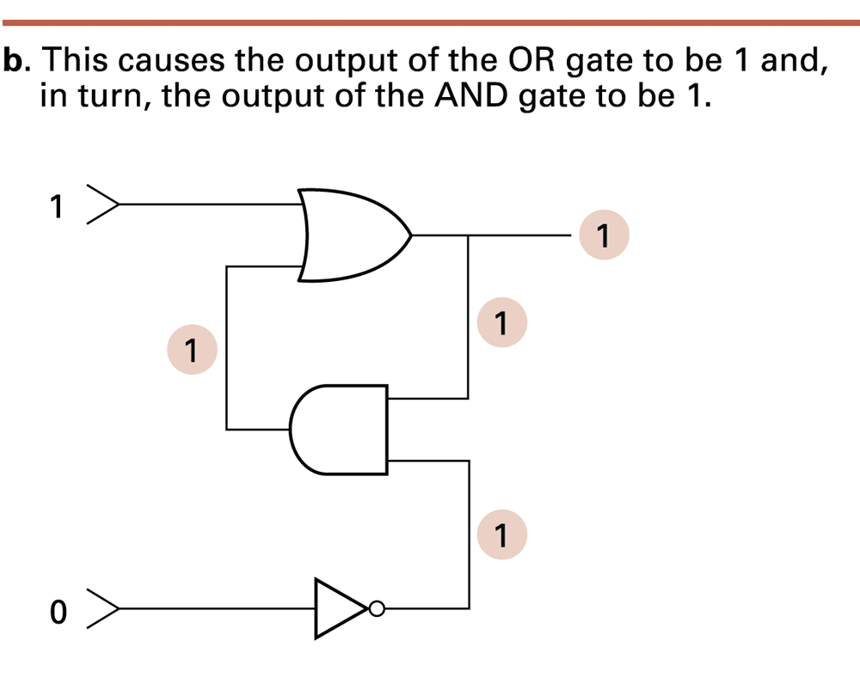
Figure 1.4 Setting the output of a flip-flop to 1 (continued)
1-<number>

Slide 50
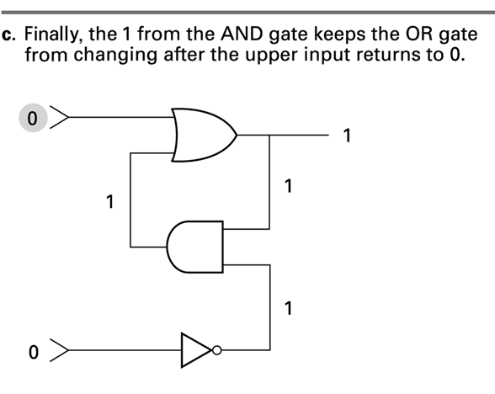
Figure 1.4 Setting the output of a flip-flop to 1 (continued)
1-<number>

Slide 51
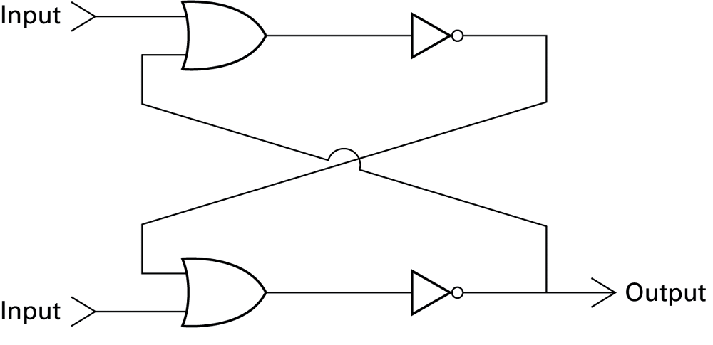
Figure 1.5 Another way of constructing a flip-flop
1-<number>

Slide 52
Assignment 2
1. Use NOR gates to construct a flip-flop.
2. Use NAND gates to construct a flip-flop.
Read on question 3 (You are not to submit Q3)
3. Find differences between Latche and Flip-flop
1-<number>

Slide 53
Hexadecimal Notation
Hexadecimal notation: A shorthand notation for long bit patterns
  Divides a pattern into groups of four bits each
  Represents each group by a single symbol
Example: 10100011 becomes A3
1-<number>

Slide 54
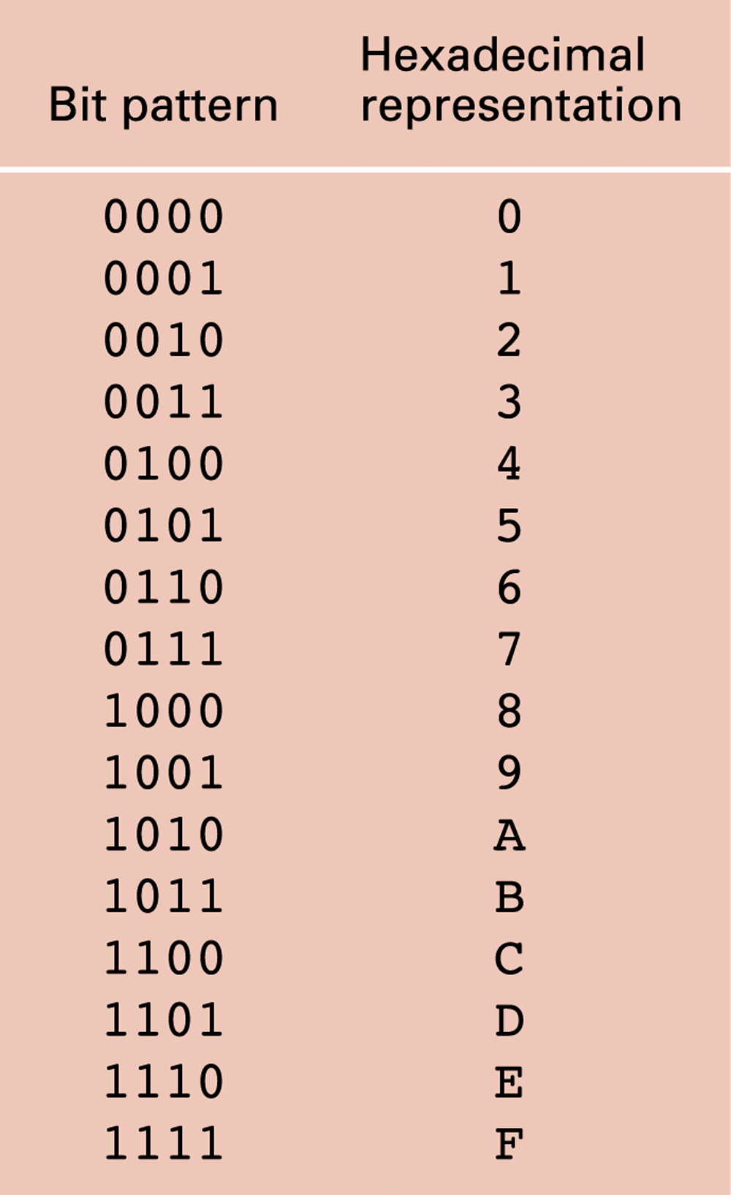
Figure 1.6 The hexadecimal coding system
1-<number>

Slide 55
Main Memory Cells
Cell: A unit of main memory (typically 8 bits which is one byte)
  Most significant bit: the bit at the left (high-order) end of the conceptual row of bits in a memory cell
  Least significant bit: the bit at the right (low-order) end of the conceptual row of bits in a memory cell
1-<number>

Slide 56
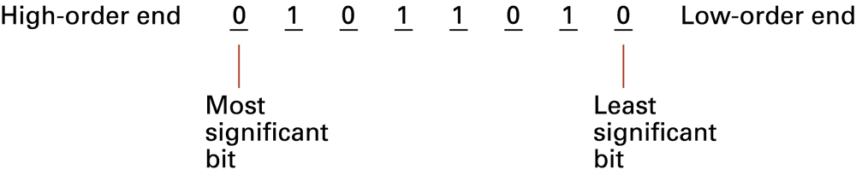
Figure 1.7 The organization of a byte-size memory cell
1-<number>

Slide 57
Main Memory Addresses
Address: A “name” that uniquely identifies one cell in the computer’s main memory
  The names are actually numbers.
  These numbers are assigned consecutively starting at zero.
  Numbering the cells in this manner associates an order with the memory cells.
1-<number>

Slide 58
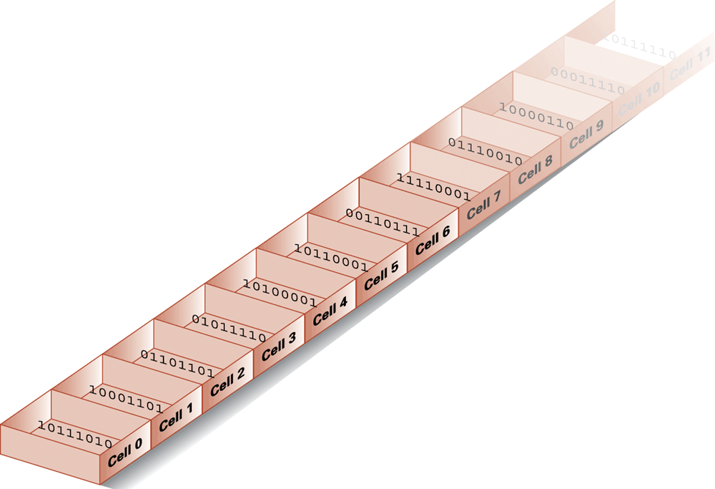
Figure 1.8 Memory cells arranged by address
1-<number>

Slide 59
Memory Terminology
Random Access Memory (RAM): Memory in which individual cells can be easily accessed in any order
Flip-flops is a means of storing bits
RAM in most modern computers is analogous,
    but more complex technologies provide greater miniaturization and
    faster response time.
1-<number>

Slide 60
Many of these technologies store bits as tiny electric charges that dissipate quickly.
Thus these devices require additional circuitry - refresh circuit, that repeatedly replenishes the charges many times a second. Therefore, they are called dynamic memory, or - Dynamic RAM (DRAM).
Dynamic Memory (DRAM): RAM composed of volatile memory
SDRAM - Synchronous DRAM,
  DRAM that applies additional techniques to decrease the time needed to retrieve the contents from its memory cells.
1-<number>

Slide 61
Measuring Memory Capacity
Bit (Binary Digit): A binary digit is logical 0 and 1
Nibble: A group of 4 bits is called nibble.
Byte: A group of 8 bits is called a byte. A byte is the smallest unit, which can represent a data item or a character.
Word: is a group of fixed number of bits processed by a computer's CPU in one go
(as a unit),
  Length of a word is called word-size or word length. It may be as small as 8 bits or may be as long as 96 bits. A computer stores the information in the form of computer words. These days, typically 32 bits or 64 bits. Data bus size, instruction size, address size are usually multiples of the word size.
Kilobyte: 2¹⁰ bytes = 1024 bytes
  Example: 3 KB = 3 times1024 bytes
Megabyte: 2²⁰ bytes = 1,048,576 bytes
  Example: 3 MB = 3 times 1,048,576 bytes
Gigabyte (GB): 2³⁰ bytes = 1,073,741,824 bytes
  Example: 3 GB = 3 times 1,073,741,824 bytes
TeraByte (TB): 1 TB = 1024 GB
PetaByte (PB): 1 PB = 1024 TB
1-<number>

Slide 62
Mass Storage
Additional devices:
  Magnetic disks
  CDs
  DVDs
Advantages over main memory
  Less volatility
  Larger storage capacities
  Low cost
  In many cases can be removed
  Magnetic tape
  Flash drives
  Solid-state disks
1-<number>

Slide 63
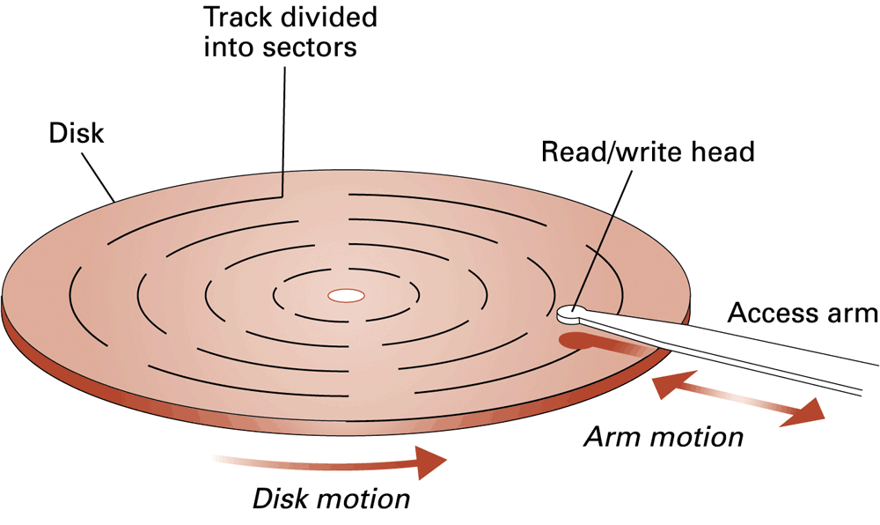
Figure 1.9 A magnetic disk storage system
1-<number>

Slide 64
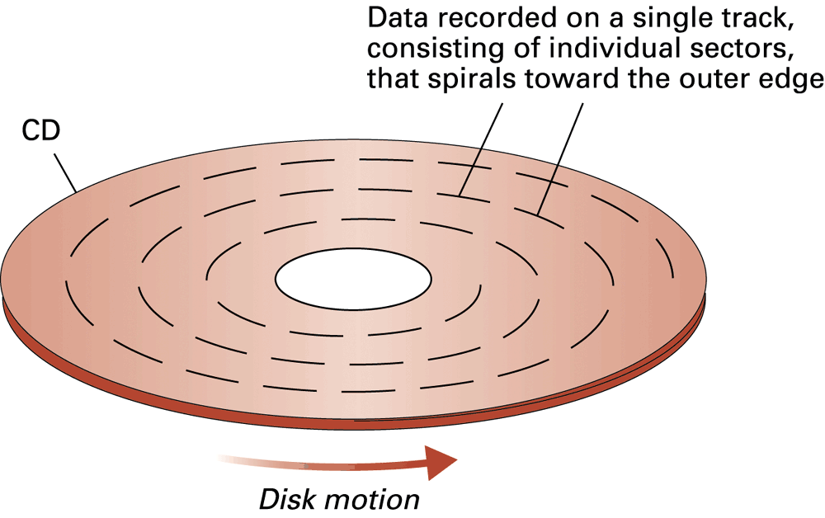
Figure 1.10 CD storage
1-<number>

Slide 65
Flash Drives
Flash Memory – circuits that traps electrons in tiny silicon dioxide chambers
Repeated erasing slowly damages the media
Mass storage of choice for:
  Digital cameras
SD Cards provide GBs of storage
  Smartphones
1-<number>

Slide 66
Representing Text
Each character (letter, punctuation, etc.) is assigned a unique bit pattern.
  ASCII: Uses patterns of 7-bits to represent most symbols used in written English text
  ISO developed a number of 8 bit extensions to ASCII, each designed to accommodate a major language group
  Unicode: Uses patterns up to 21-bits to represent the symbols used in languages world wide, 16-bits for world’s commonly used languages
1-<number>

Slide 67
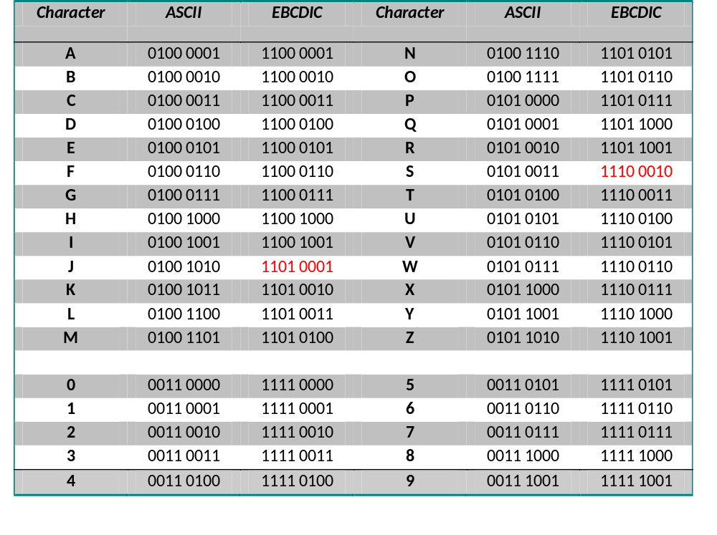
Table 1.1
Notes:
EBCDIC character set
EBCDIC which stands for the Extended Binary Coded Decimal Interchange Code, is an 8 bit character encoding used on IBM mainframes.
Single byte EBCDIC takes up eight bits, which are divided in two pieces. The first four bits are called the zone and represent the category of the character, whereas the last four bits are the calledS digit and identify the specific character.

Slide 68
Figure 1.11 The message “Hello.” in ASCII or UTF-8 encoding
1-<number>
Notes:
UTF stands for Unicode Transformation Format. The '8' means it uses 8-bit blocks to represent a character

Slide 69
Representing Numeric Values
Binary notation: Uses bits to represent a number in base two
Limitations of computer representations of numeric values
  Overflow: occurs when a value is too big to be represented
  Truncation: occurs when a value cannot be represented accurately
1-<number>

Slide 70
Representing Images
Bit map techniques
  Pixel: short for “picture element”
  RGB
  Luminance – brightness, and
  chrominance – colour.
  Eg. Photographic Experts Group (JPEG), Portable Network Graphics (PNGs), GIF, TIFF.
Vector techniques
  Scalable, Flexibility
  mathematical formulas rather than individual colored blocks
  TrueType and PostScript
  Eg. Adobe Illustrator (AI), PDF, Encapsulated Postscript Vector graphics (EPS) (Adobe Illustrator), & Scalable Vector Graphics (SVG)
1-<number>
Notes:
The RGB color model is an additive color model in which red, green and blue light are added together in various ways to reproduce a broad array of colors. The name of the model comes from the initials of the three additive primary colors, red, green, and blue.
Vector images, alternatively, allow for more flexibility. Constructed using mathematical formulas rather than individual colored blocks, vector file types such as EPS, AI and PDF*

Slide 71
Representing Sound
Sampling techniques
  Used for high quality recordings
  Records actual audio
MIDI (Musical Instrument Digital Interface)
  Used in music synthesizers
  Records “musical score”
1-<number>

Slide 72
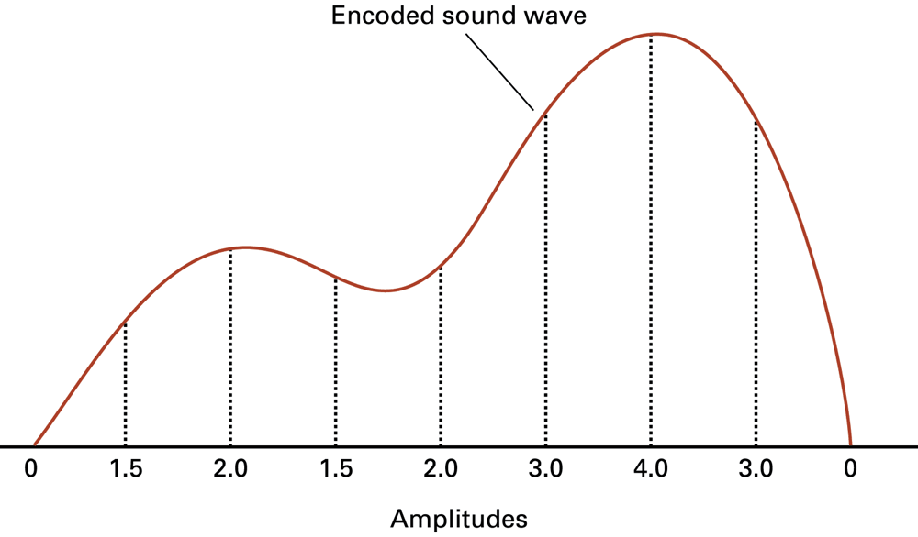
Figure 1.12 The sound wave represented by the sequence 0, 1.5, 2.0, 1.5, 2.0, 3.0, 4.0, 3.0, 0
1-<number>

Slide 73
The Binary System
The traditional decimal system is based
on powers of ten.
The Binary system is based on powers
of two.
1-<number>

Slide 74
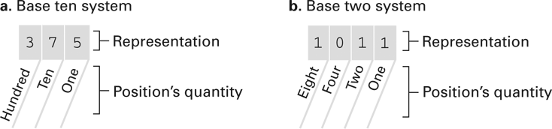
Figure 1.13 The base ten and binary systems
1-<number>

Slide 75
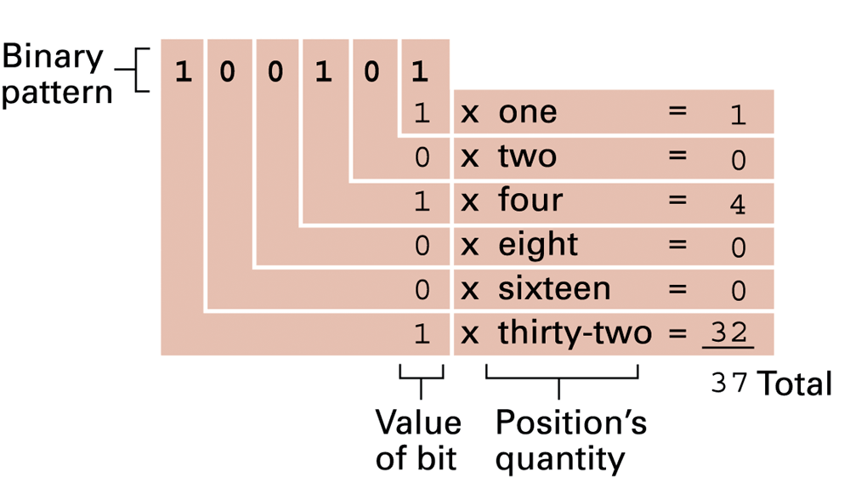
Figure 1.14 Decoding the binary representation 100101
1-<number>

Slide 76
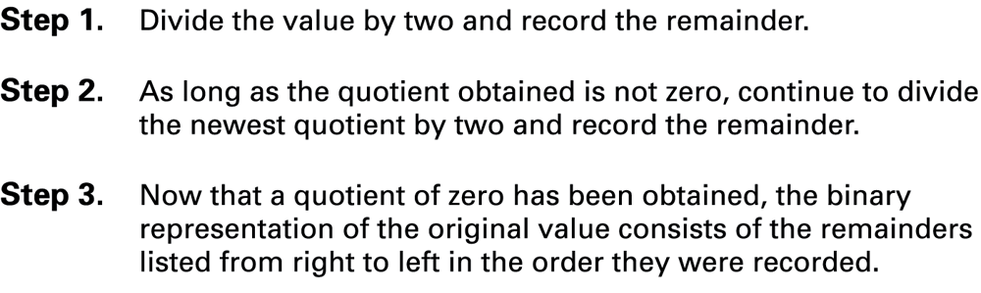
Figure 1.15 An algorithm for finding the binary representation of a positive integer
1-<number>

Slide 77
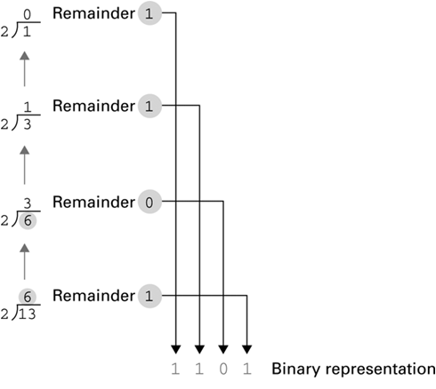
Figure 1.16 Applying the algorithm in Figure 1.15 to obtain the binary representation of thirteen
1-<number>

Slide 78
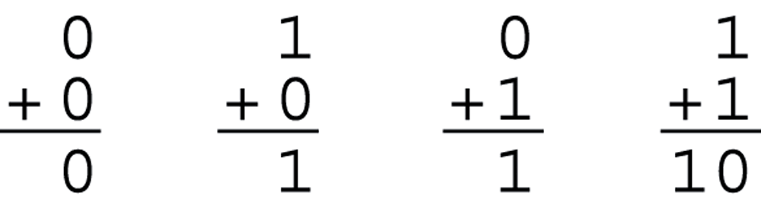
Figure 1.17 The binary addition facts
1-<number>

Slide 79
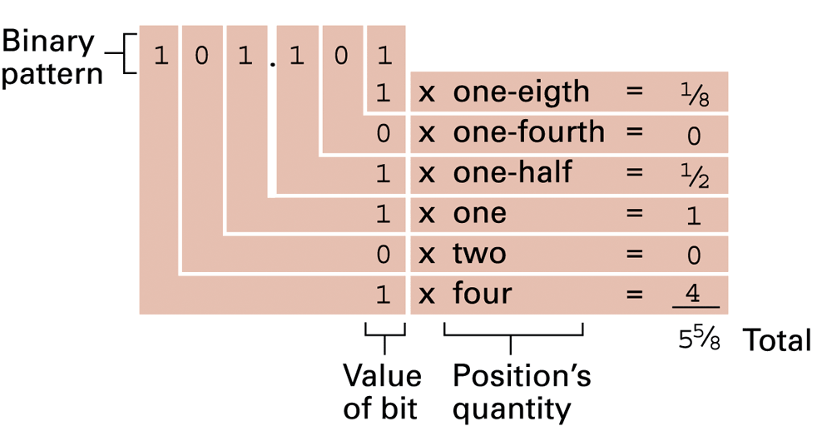
Figure 1.18 Decoding the binary representation 101.101
1-<number>

Slide 80
Storing Integers
Two’s complement notation: The most popular means of representing integer values
Excess notation: Another means of representing integer values
Both can suffer from overflow errors
1-<number>

Slide 81
Storing integers
How the computer stores both positive and negative numbers.
Not commonly used ways
  Sign and magnitude
  One’s complement
Commonly used one
  Two’s complement
1-<number>

Slide 82
bin | dec
000 | 0
001 | 1
010 | 2
011 | 3
100 | 4
101 | 5
110 | 6
111 | 7
1-<number>

Slide 83
3 bit system
Anytime you have n bits
2 to the power n possible values
E.g. 3 bit system = 8 values
I use 3 bit system to keep it simple and small
So 4 bit system = 16 values.
With 3 bits all of the concepts can still be explained
1-<number>

Slide 84
Unsigned bits
Signed bits (+ve & -ve) values
Sign and Magnitude
Leading zeros for all +ves
Leading ones for all –ves
Drawbacks :
  2 zeroes problem, and –ve zero makes even a less intuitive sense
  Its difficult for hardware implementation
1-<number>

Slide 85
One’s complement
  Original value
  To get –ve, flip bits
Drawbacks
  2 zeroes problem, or –ve zero makes even a less intuitive sense
  Its difficult for hardware implementation
1-<number>

Slide 86
Two complement
  Original value
    To get the -ve value
  Flip bits and add 1.
  Basic things apply
  -ve1 is always all 1s regardless of the number of bits
  The smallest –ve number will always be a leading 1, followed by all zeros
  The largest +ve number will always be a leading 0 followed by all ones.
  One benefits of 2’s complement is that we can implement our addition and subtraction as simple addition. Which means we can do everything with an Adder.
1-<number>

Slide 87
Addition problems
2+1 = 3; 011+ 001=011
3-1=2; 011+ 111 = 1010
Ignore the carry, because we have 3 bit system
2-4= -2: 010 + 100 = 110
Scenario that will cause a problem
3 + 2 = 5: but we don’t have a 5 in the binary representation
011 + 010 = 101; 2 +ve numbers resulting in –ve number is an overflow condition and we can report that as an error.
-4 – 3 = -7: 100 + 101= 1001: 2 -ve numbers resulting in +ve number is an overflow condition and we can report that as an error.
1-<number>

Slide 88
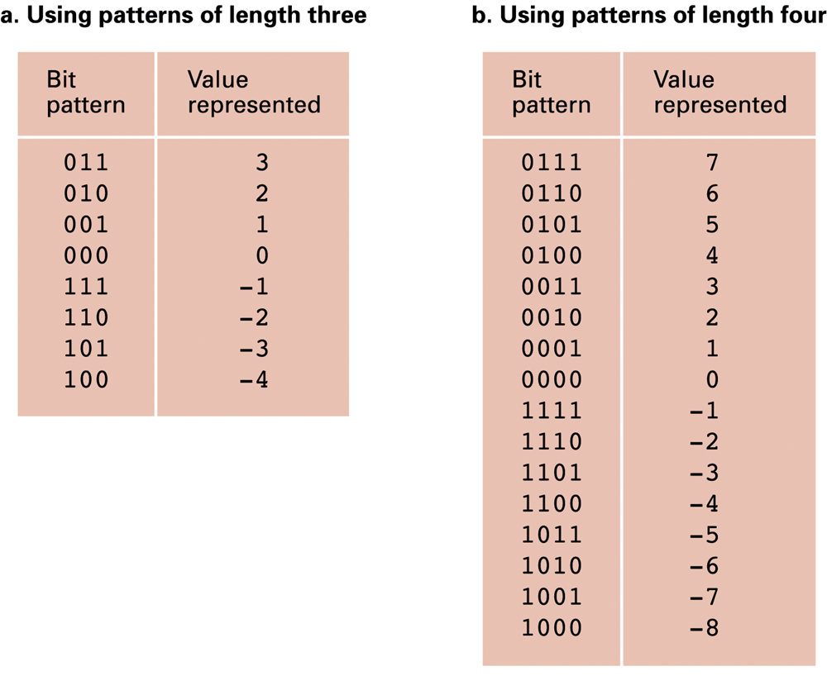
Figure 1.19 Two’s complement notation systems
1-<number>

Slide 89
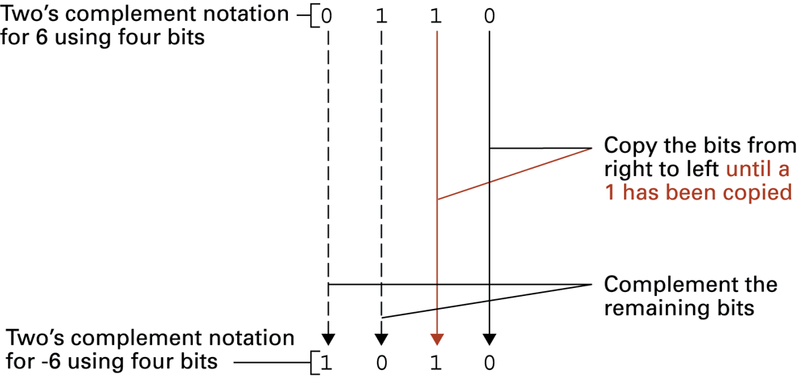
Figure 1.20 Coding the value -6 in two’s complement notation using four bits
1-<number>

Slide 90
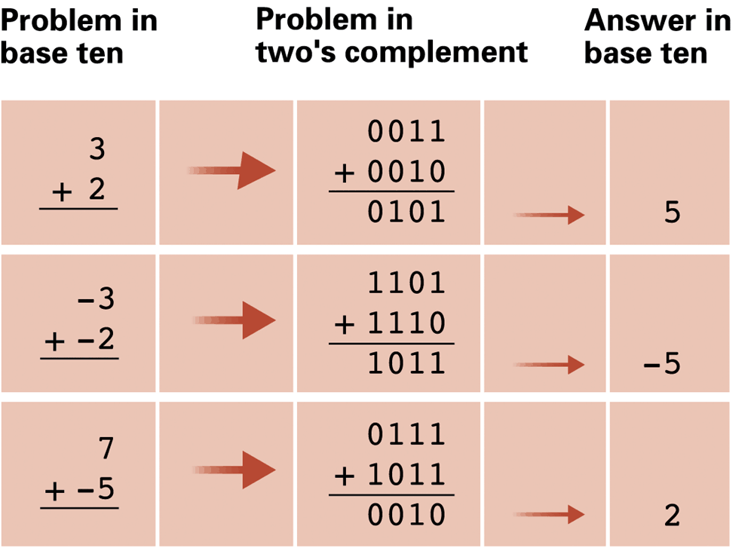
Figure 1.21 Addition problems converted to two’s complement notation
1-<number>

Slide 91
Example:
Example: 3 in 8-bit signed binary notation is 00000011. To flip the sign, you first flip all bits (11111100), then add 1 (11111101). So, -3 is 11111101. To flip the sign again, you first flip all bits (00000010), then add 1 (00000011), and you can see that this is the same 3.
1-<number>

Slide 92
Two’s complement
deals with the 2 zeros problem- we no longer have the 2 zeros.
allows us to do addition and subtraction with only addition which makes it easier to implement hardware.
enables us to detect overflow condition so that we can report errors.
1-<number>

Slide 93
Excess Notation
A different way of expressing –ve numbers in binary
It comes with a set of digit length
  3 bit excess notation
  6 bit excess notation
  8 bit excess notation
1-<number>

Slide 94
Excess Notation
0 = 1, followed by as many 0s as possible
Example
  3 bits excess 0 = 100
  4 bits excess 0 = 1000
  5 bits excess 0 = 10000
  6 bits excess 0 = 100000
NB: 0 is not a sign-less number anymore. It is neither +ve nor –ve.
But we assigned 1 to it. Every +ve number starts with a 1.
Hence, it is not commonly used as the 2’s complement.
1-<number>

Slide 95
Building up the excess notation
Peculiarities:
When you flip 0 you get -1. Ideally, it is when you flip +1 that we should get -1.
There are troubles with addition, eg.
It works with adding +ve numbers
but adding –ve numbers gives problems. eg.(-4) + (-3) = (-7)
1-<number>

Slide 96
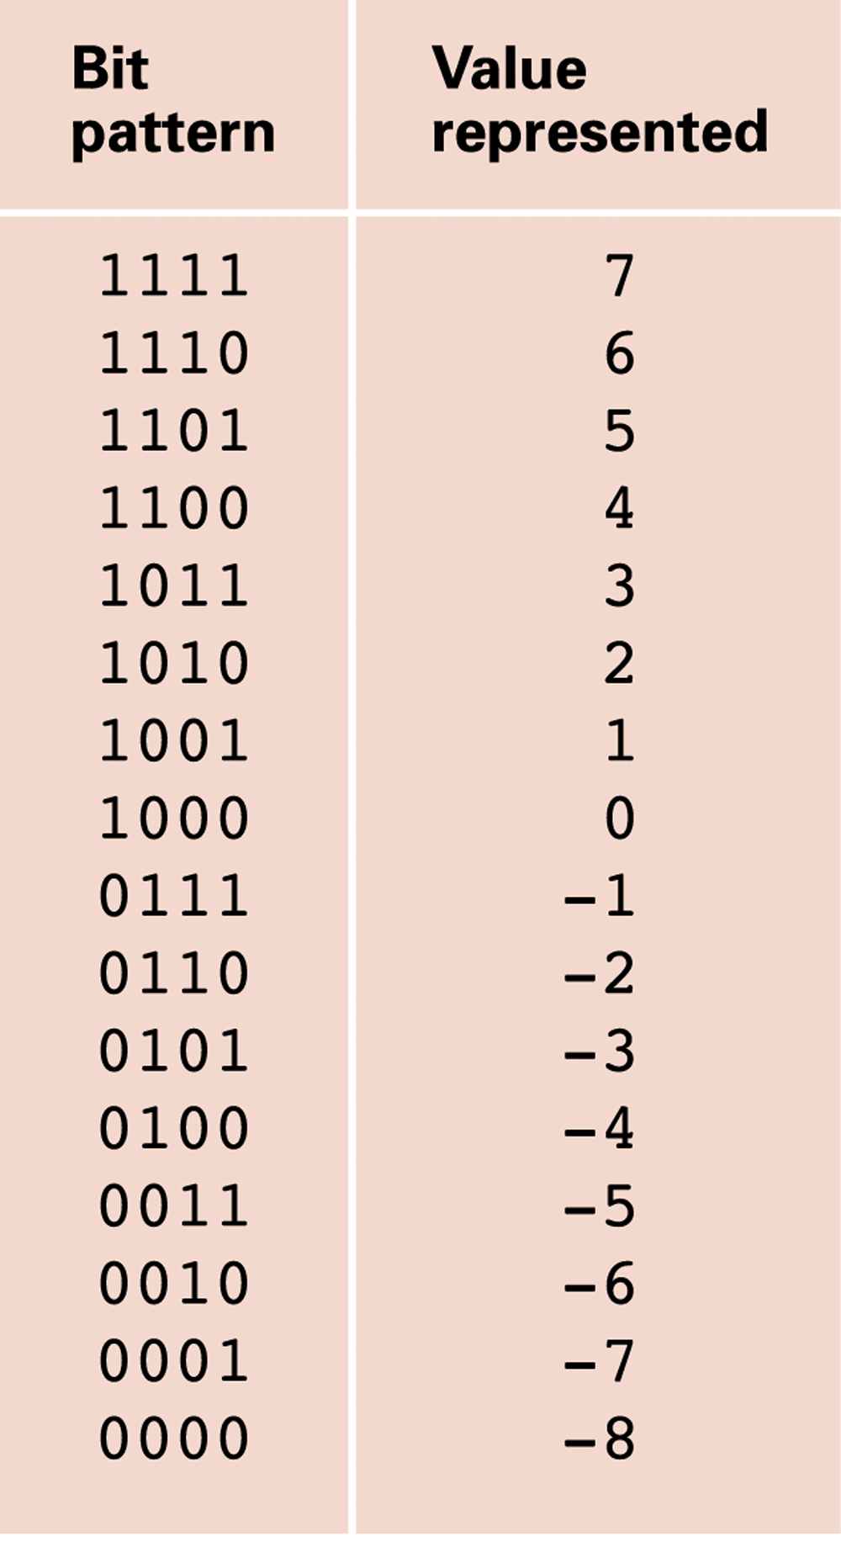
Figure 1.22 An excess eight conversion table
1-<number>

Slide 97
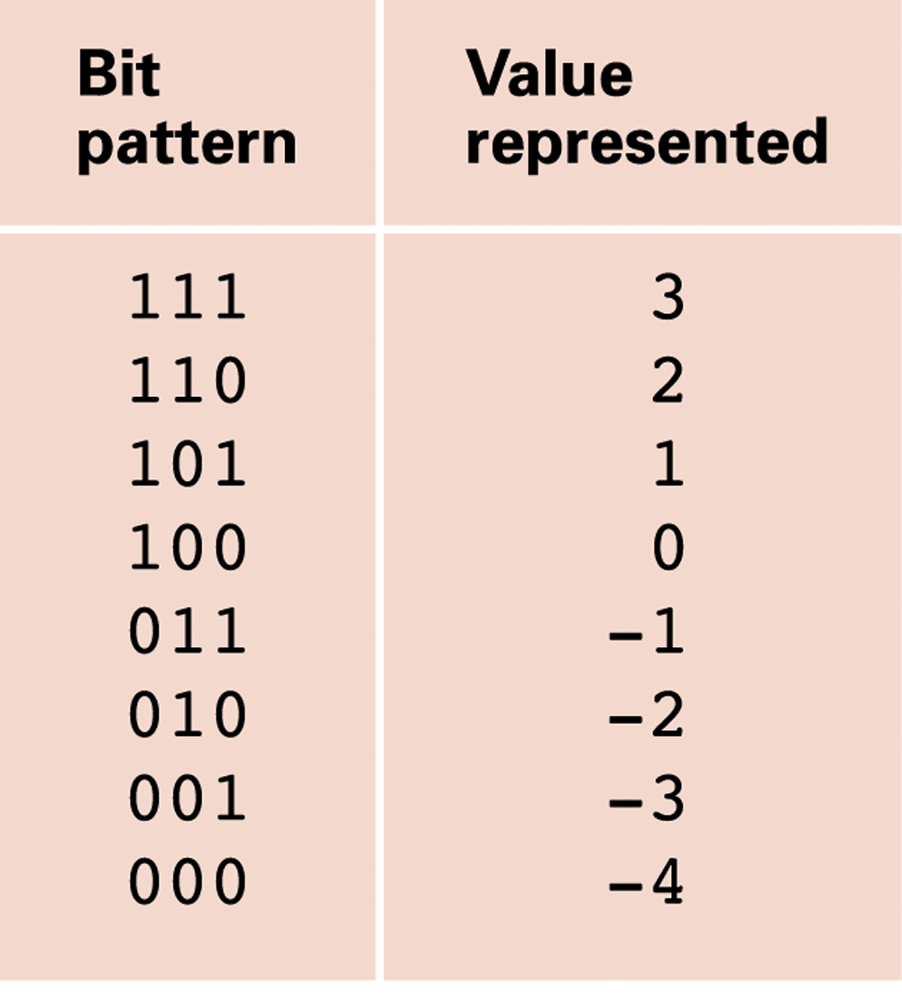
Figure 1.23 An excess notation system using bit patterns of length three
1-<number>

Slide 98
Negative Numbers
We can represent negative numbers in several ways.
The simplest is to simply use the leftmost digit of the number as a special value to represent the sign of the number: 0 = positive, 1 = negative.
For example, a value of positive 12 (decimal) would be written as 01100 in binary, but negative 12 (decimal) would be written as 11100.
Notice that in this system, it is important to show the leading 0 (to indicate a positive value).
1-<number>

Slide 99
For technical reasons, the "two's complement" is more often used for representing negative numbers. In this system, a positive 12 is still 01100, but -12 would be written as 10100.
Notice that there is nothing intrinsically correct about one system over another. Either 11100 or 10100 can be used to represent -12, it just depends on what system of interpretation is used. That is, a human programmer chooses the meaning of the bits.
1-<number>

Slide 100
Storing Fractions
Floating-point Notation: Consists of a sign bit, a mantissa field, and an exponent field.
Related topics include
  Normalized form
  Truncation errors
1-<number>

Slide 101
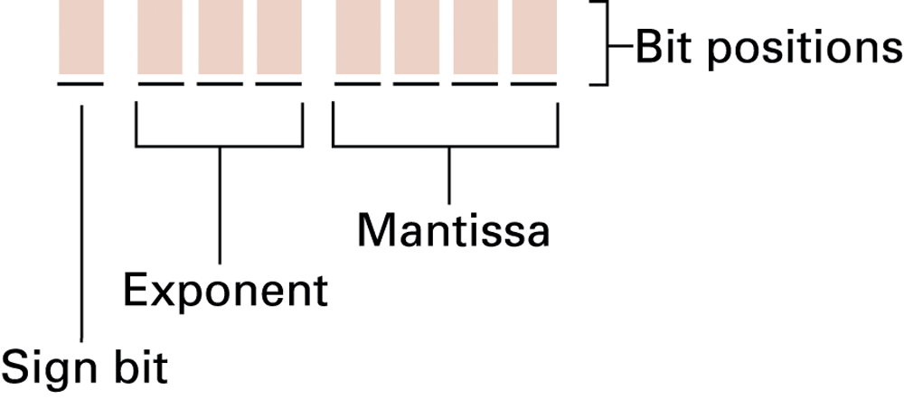
Figure 1.24 Floating-point notation components
1-<number>

Slide 102
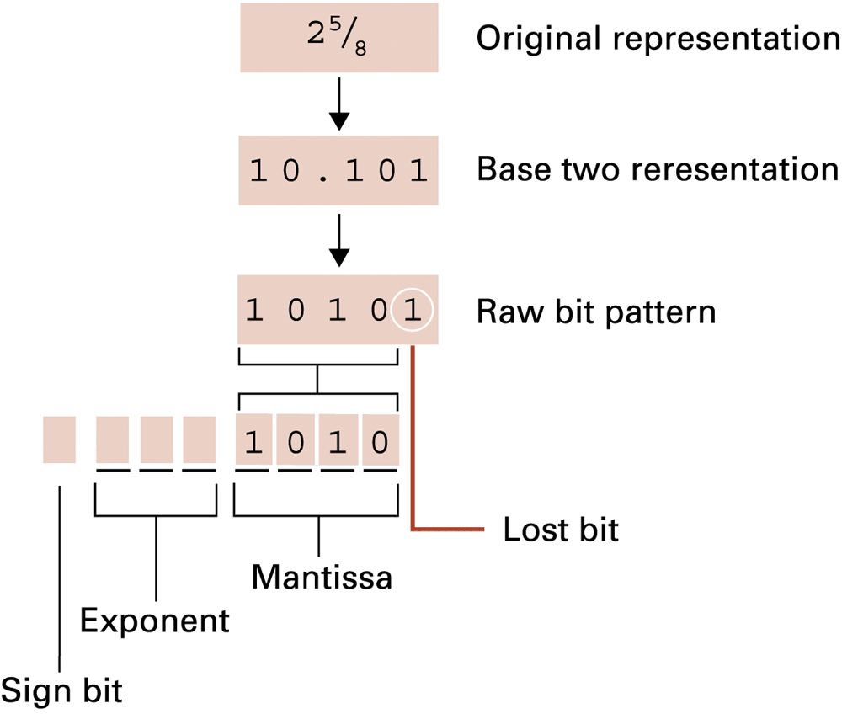
Figure 1.25 Encoding the value 2 ⁵⁄₈
1-<number>

Slide 103
Data and Programing
A programming language is a computer system created to allow humans to precisely express algorithms using a higher level of abstraction.
1-<number>

Slide 104
Getting Started with Python
Python: a popular programming language for applications, scientific computation, and as an introductory language for students
Freely available from www.python.org
Python is an interpreted language
  Typing:
    print('Hello, World!')
  Results in:
  Hello, World!
1-<number>

Slide 105
Variables
Variables: name values for later use
Analogous to mathematic variables in algebra
    s = 'Hello, World!'
    print(s)
    my_integer = 5
    my_floating_point = 26.2
    my_Boolean = True
    my_string = 'characters'
    my_integer = 0xFF
1-<number>

Slide 106
Operators and Expressions
    print(3 + 4) # Prints 7
print(5 – 6) # Prints -1
print(7 * 8) # Prints 56
print(45 / 4) # Prints 11.25
print(2 ** 10) # Prints 1024
s = 'hello' + 'world'
s = s * 4
print(s)
1-<number>

Slide 107
Currency Conversion
# A converter for currency exchange.
USD_to_GBP = 0.66 # Today's exchange rate
GBP_sign = '\u00A3' # Unicode value for £
dollars = 1000 # Number dollars to convert
# Conversion calculations
pounds = dollars * USD_to_GBP
# Printing the results
print('Today, $' + str(dollars))
print('converts to ' + GBP_sign + str(pounds))
1-<number>

Slide 108
Debugging
Syntax errors
    print(5 +)
    SyntaxError: invalid syntax
    pront(5)
    NameError: name 'pront' is not defined
Semantic errors
  Incorrect expressions like
  total_pay = 40 + extra_hours * pay_rate
Runtime errors
  Unintentional divide by zero
1-<number>

Slide 109
Data Compression
Lossy versus lossless
Run-length encoding
Frequency-dependent encoding
(Huffman codes)
Relative encoding
Dictionary encoding (Includes adaptive dictionary encoding such as LZW encoding.)
1-<number>

Slide 110
Compressing Images
GIF: Good for cartoons
JPEG: Good for photographs
TIFF: Good for image archiving
1-<number>

Slide 111
Compressing Audio and Video
MPEG
  High definition television broadcast
  Video conferencing
MP3
  Temporal masking
  Frequency masking
1-<number>

Slide 112
Communication Errors
Parity bits (even versus odd)
Checkbytes
Error correcting codes
1-<number>

Slide 113
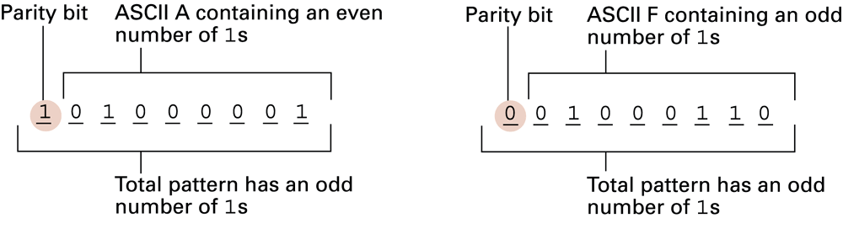
Figure 1.26 The ASCII codes for the letters A and F adjusted for odd parity
1-<number>

Slide 114
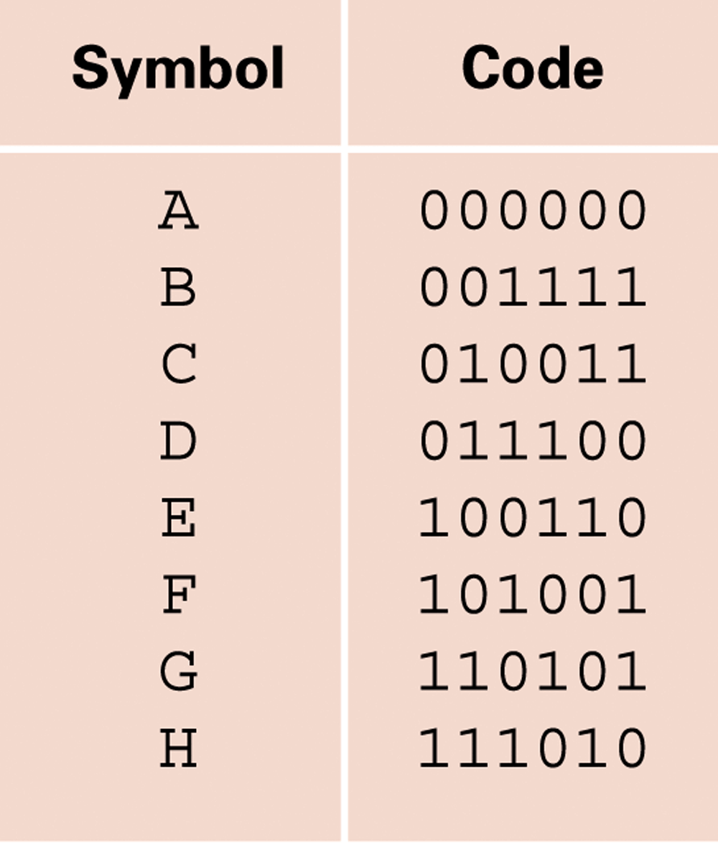
Figure 1.27 An error-correcting code
1-<number>

Slide 115
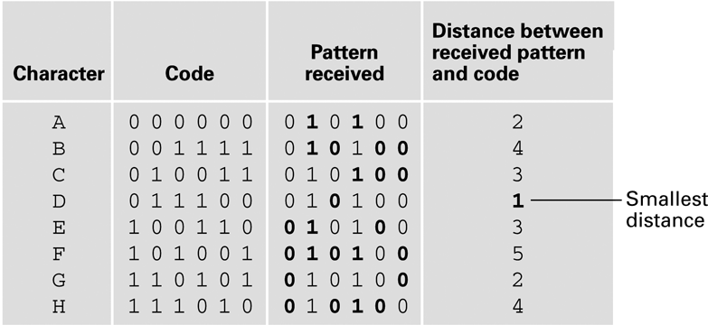
Figure 1.28 Decoding the pattern 010100 using the code in Figure 1.27
1-<number>

